Slide 1
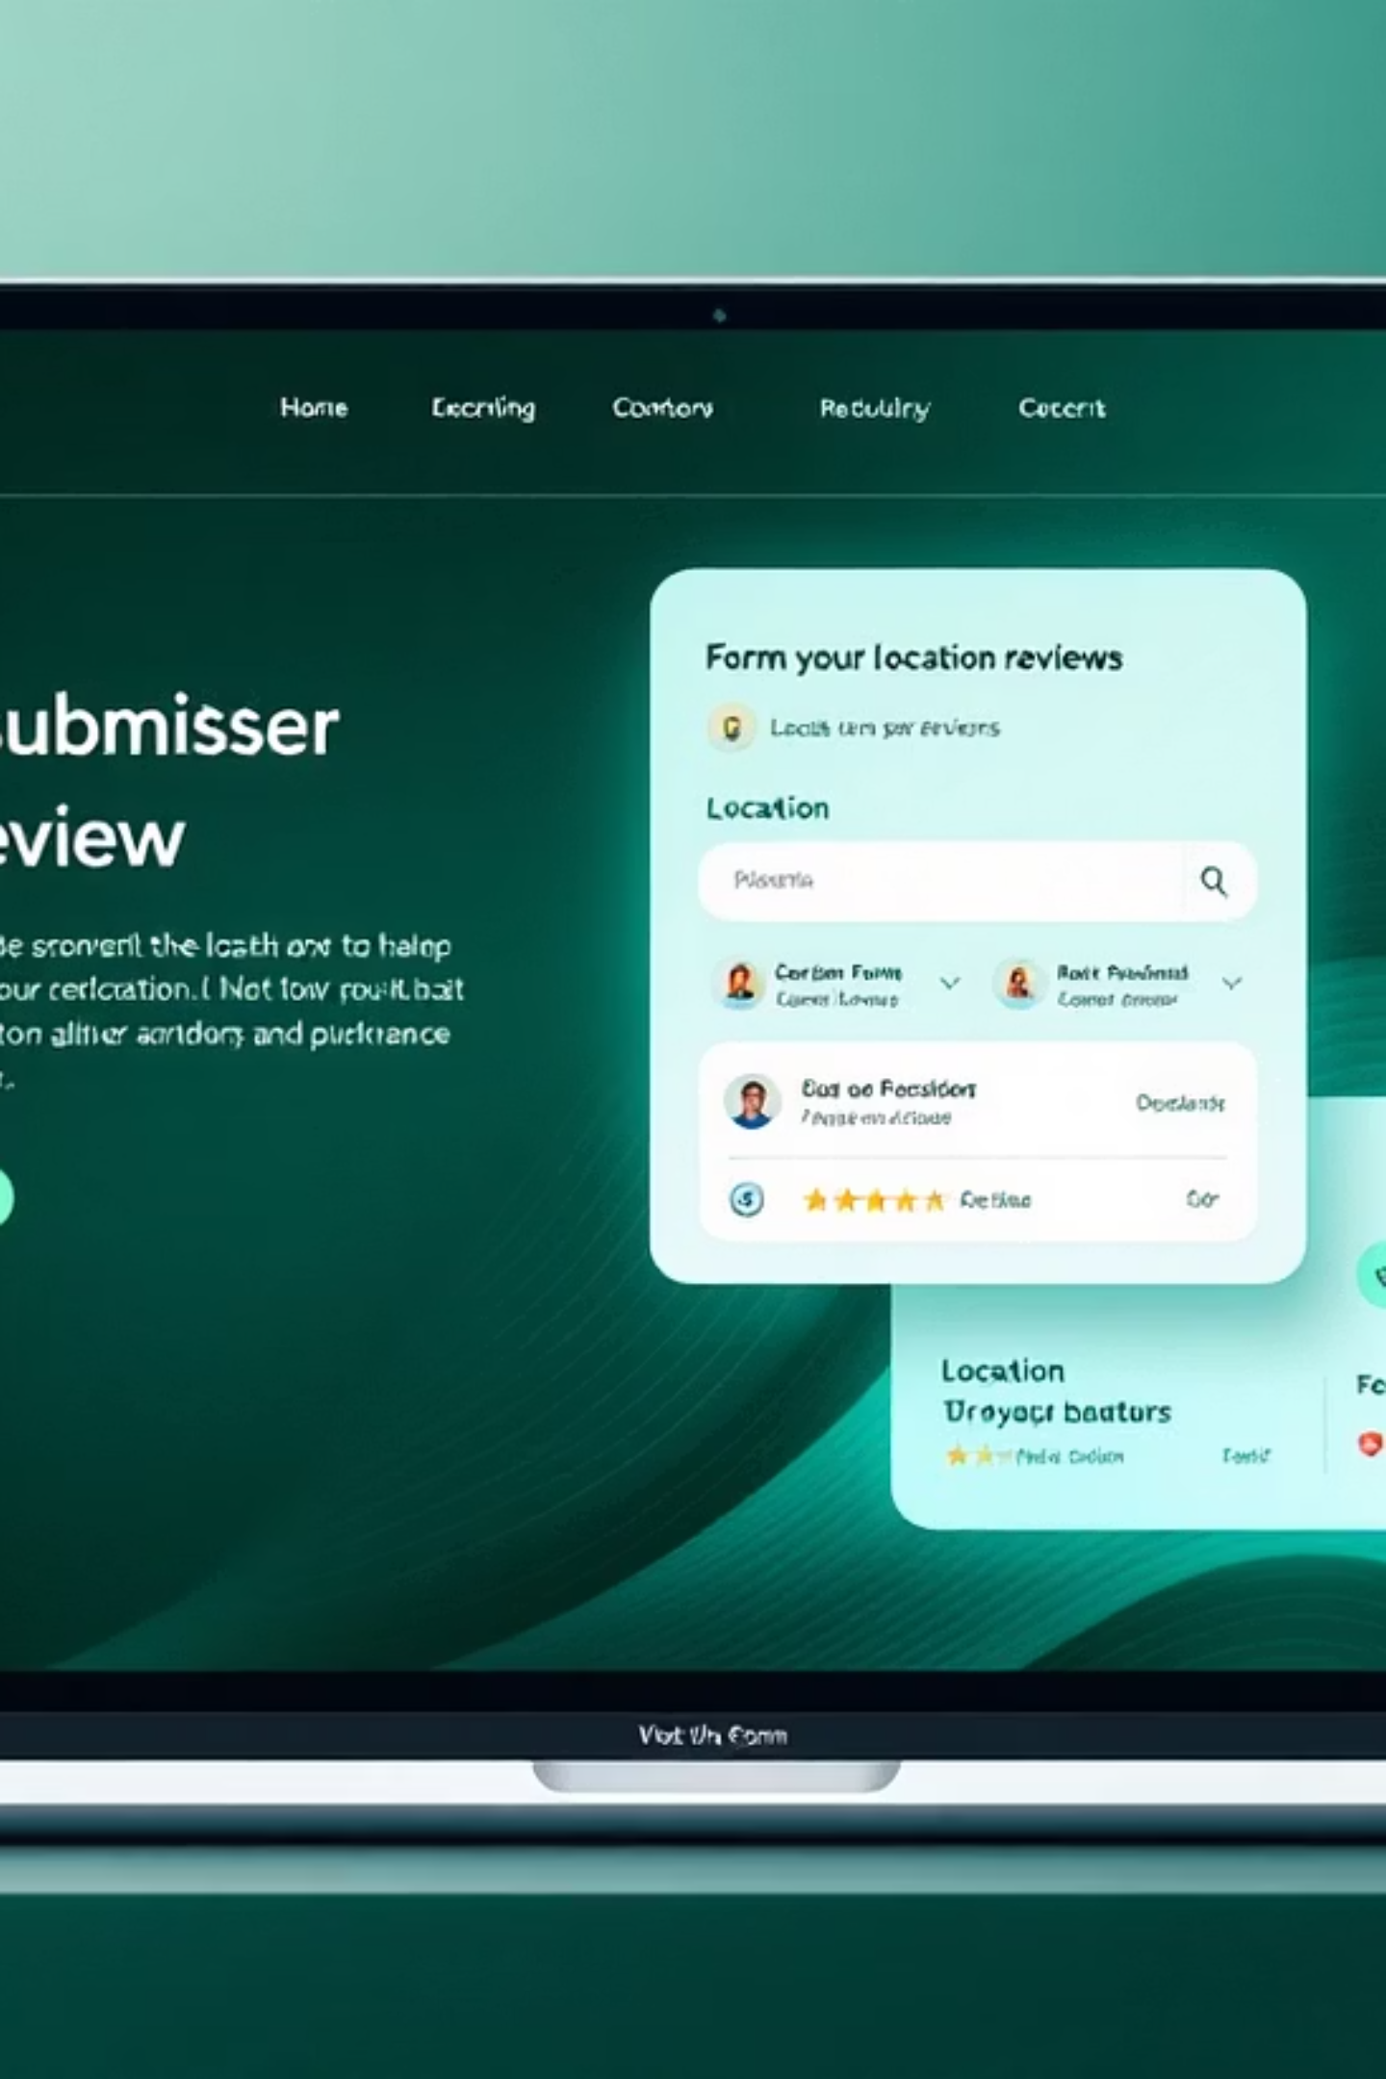
FormFlow: Streamlined Form Submission & Location Reviews
Welcome to FormFlow, the comprehensive web application designed to simplify your form submission experience. Today, we'll explore our two core features: the Biography Information form and the Location Review system.

Slide 2

Feature A: Direct Biography Form Access
The Old Way vs. The New Way
Previously, users had to search and manually navigate to FormA for submitting biographical information.
Our new integration allows direct access from website B, eliminating multiple steps and streamlining the user experience.
Benefits:
Reduced navigation time
Seamless transitions between platforms
Improved completion rates
Live demonstration with video1.mp4

Slide 3
Alternative Navigation Methods
Complete & Submit
Select Biography Form
Fill in required fields and submit with a single click.
Access the Dashboard
Choose the Biography Information option from the forms menu.
Navigate to your personal dashboard after logging in to access all available forms.
Watch video2.mp4 for a step-by-step demonstration

Slide 4
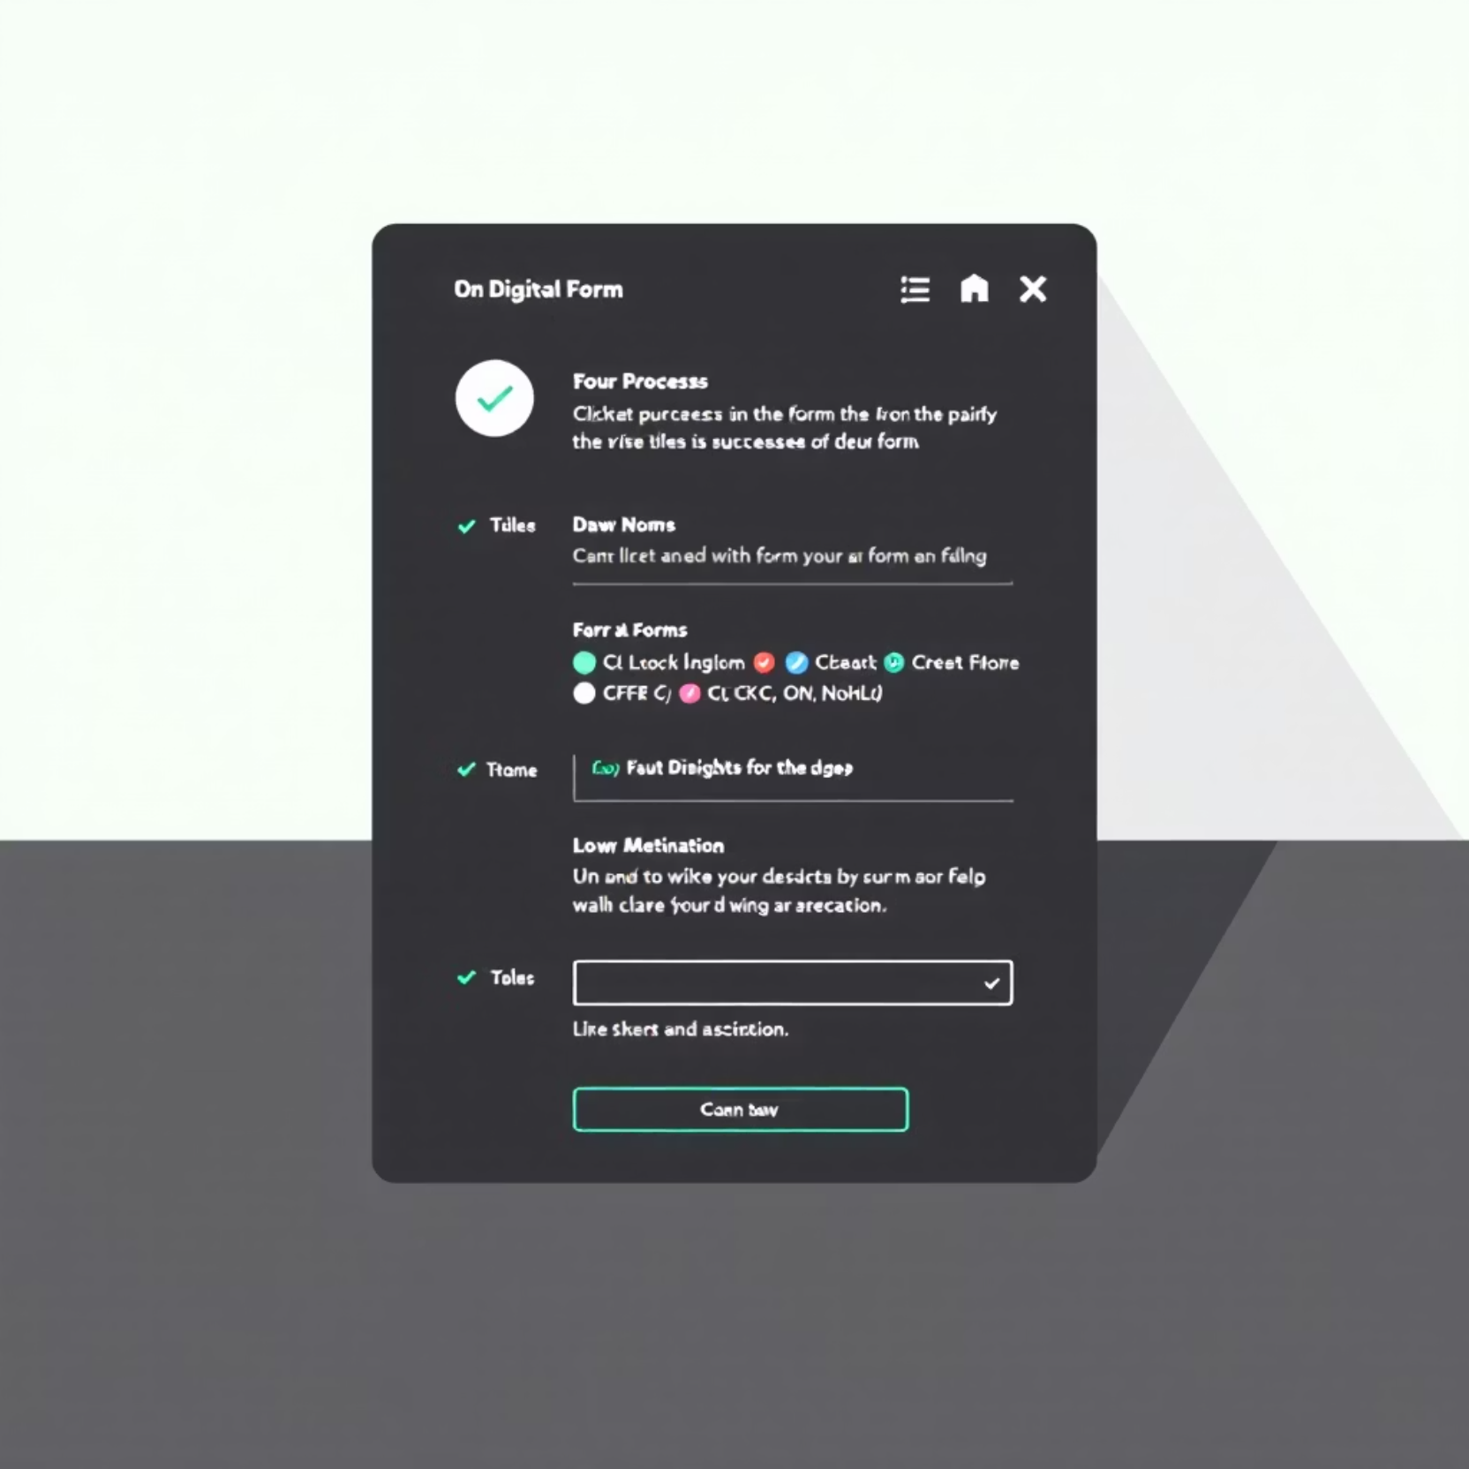
Post-Processing View
What Happens After Submission?
Once your biographical information is submitted, our system processes the data through several validation steps.
Data verification checks
Auto-formatting of entries
Cross-referencing with existing records
Video3.mp4 demonstrates the complete post-processing view that confirms successful submission.

Slide 5




Feature B: Location Review Submission
Access Form B
Complete Fields
Submit Review
Navigate directly to our Location Review form from the main dashboard.
Enter location details, rating, and your personal review experience.
Click submit to process your location feedback.
Video4.mp4 provides a complete walkthrough of the submission process

Slide 6
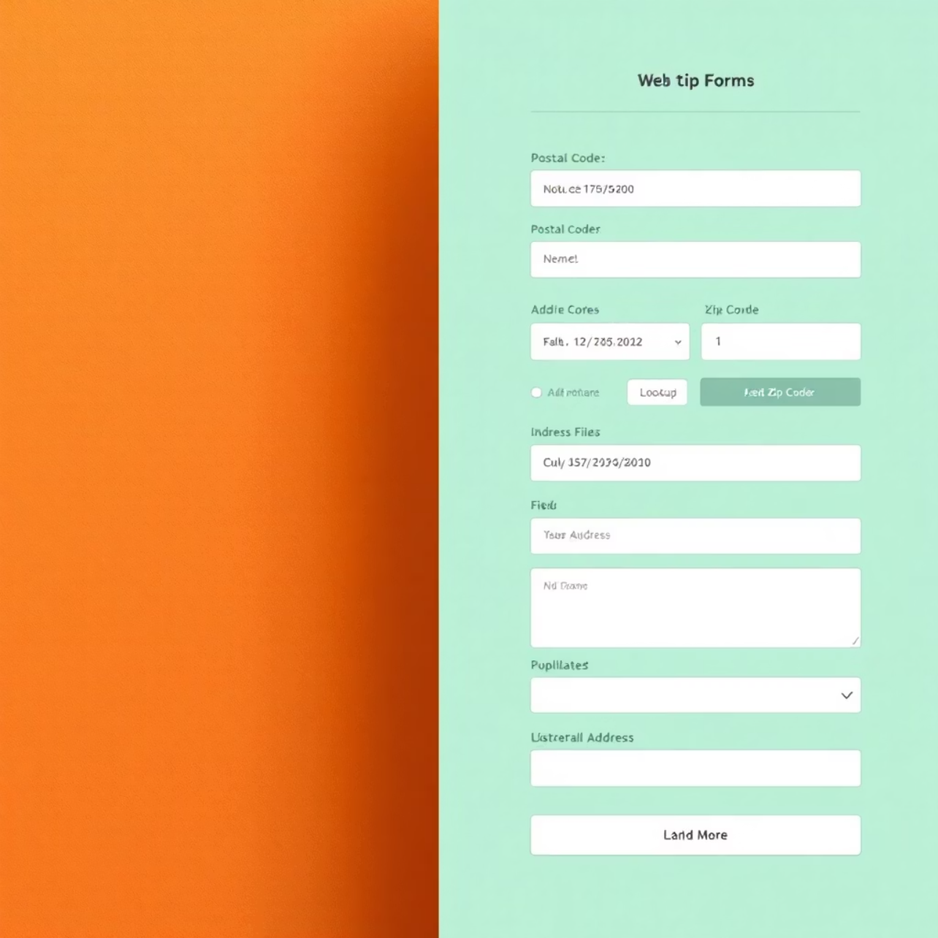
Smart Address Auto-Complete
U.S. Postal Code Lookup
Our intelligent form includes a powerful time-saving feature for U.S. locations:
Enter only the postal code (ZIP)
System automatically populates city, state, and street data
Verify and adjust any details as needed
This feature reduces form completion time by up to 40% and minimizes data entry errors.
See it in action in video5.mp4

Slide 7
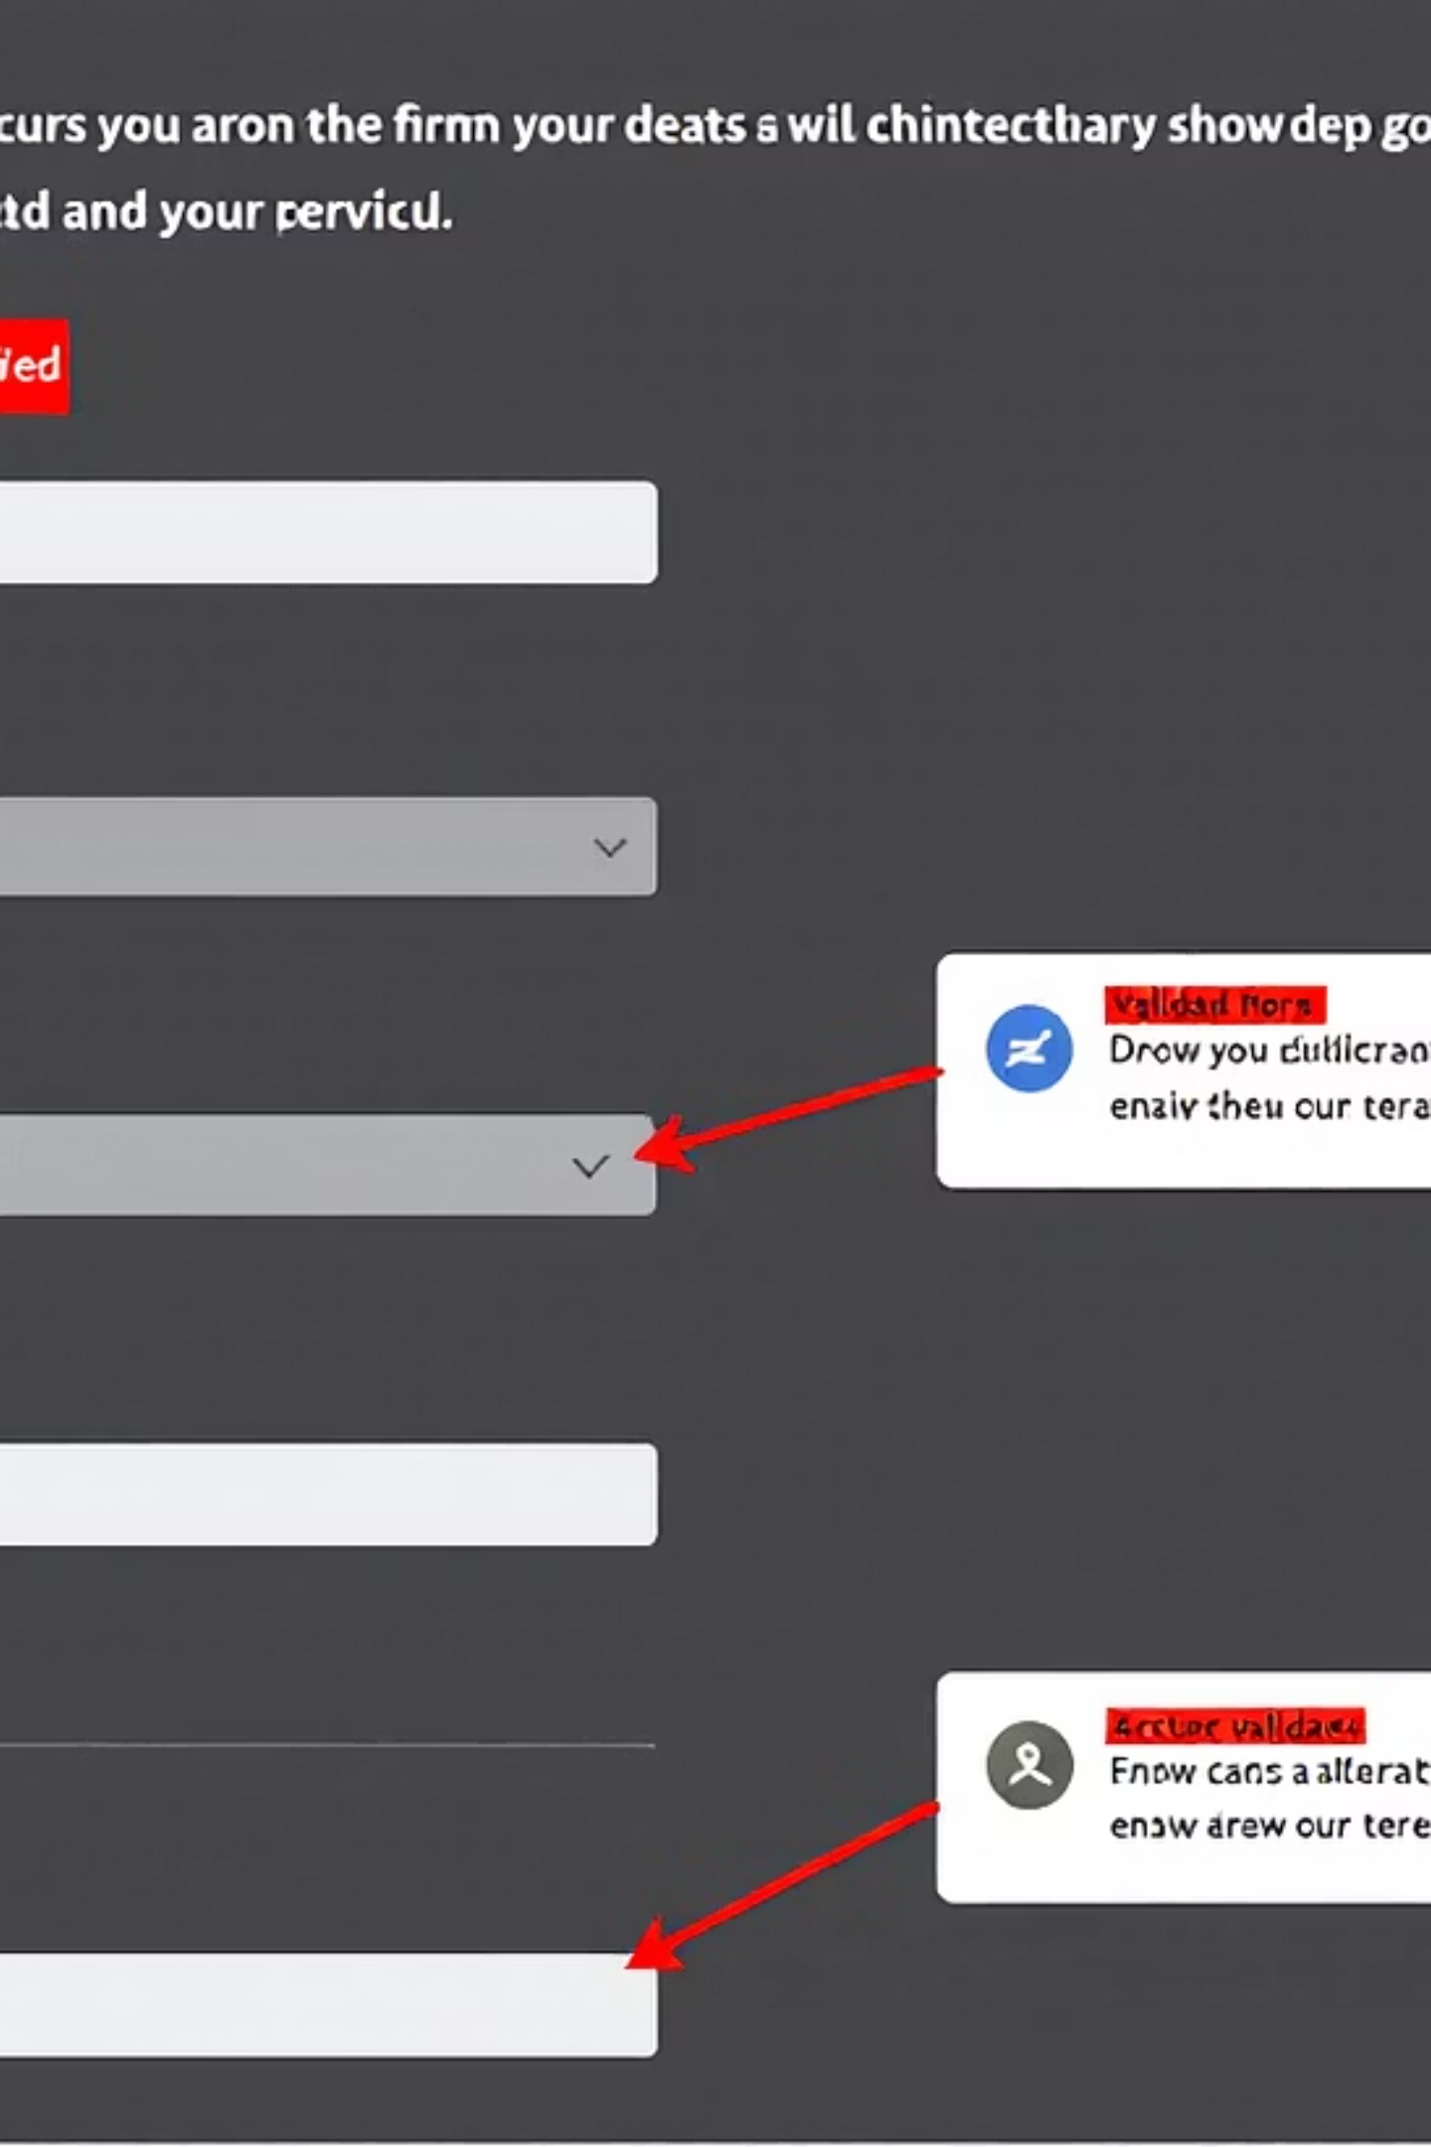
Form Validation Results
Real-Time Validation
Clear Error Messages
Our system performs automatic checks on all submitted data, highlighting any issues immediately.
When validation fails, users receive specific guidance on how to correct each field.
Quick Resolution
Fix issues without losing previously entered information and resubmit with a single click.
Video6.mp4 demonstrates the validation process for failed submissions

Slide 8
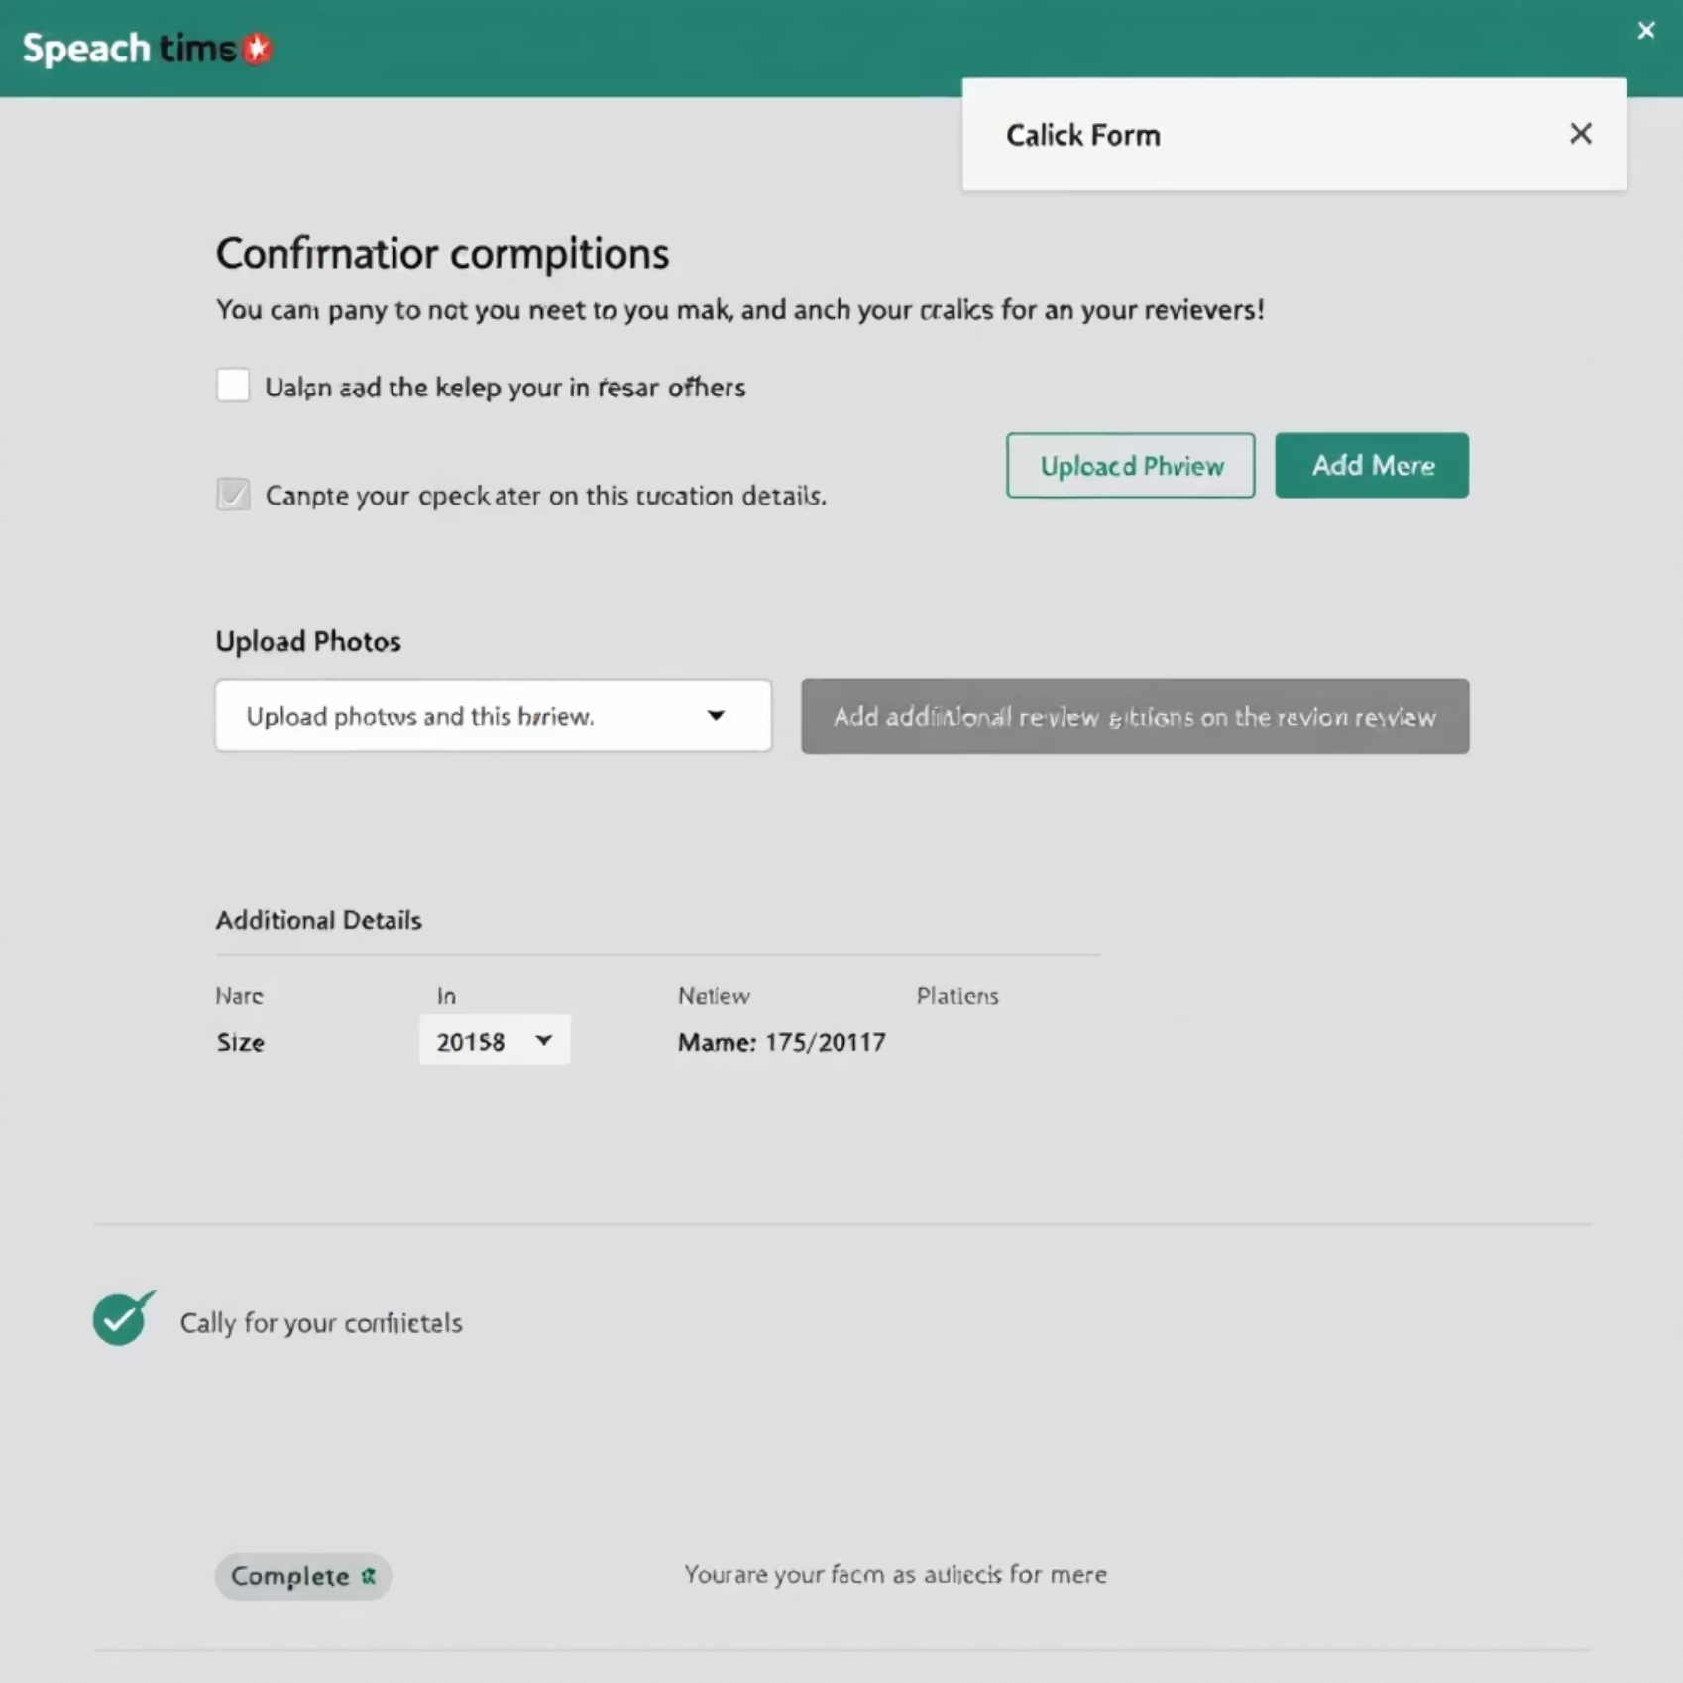
Successful Submission & Review Upload
Post-Submission Process
After successful form processing, users can enhance their location review with additional content:
Upload photos of the location
Add rating details across multiple categories
Provide specific feedback on services or amenities
Tag special features or accessibility options
Video7.mp4 shows the complete upload and review process

Slide 9
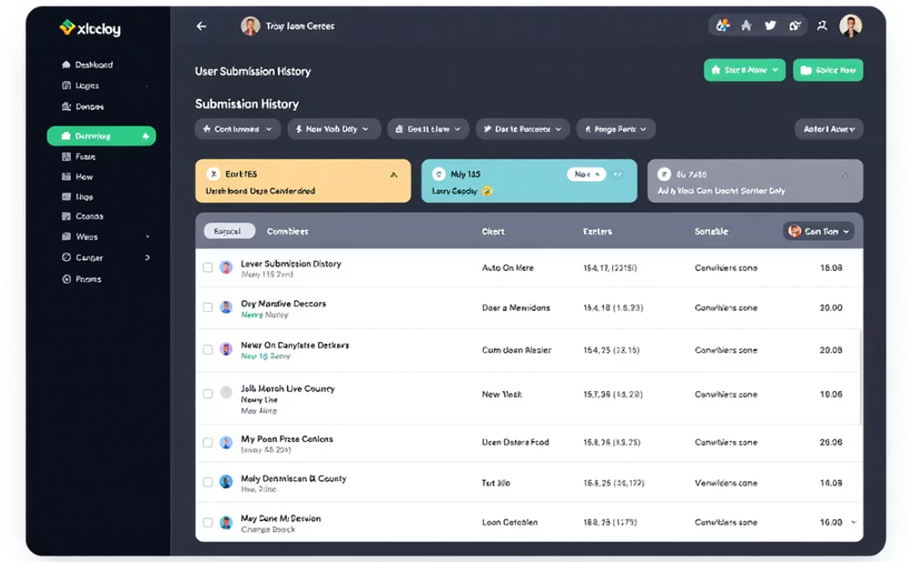
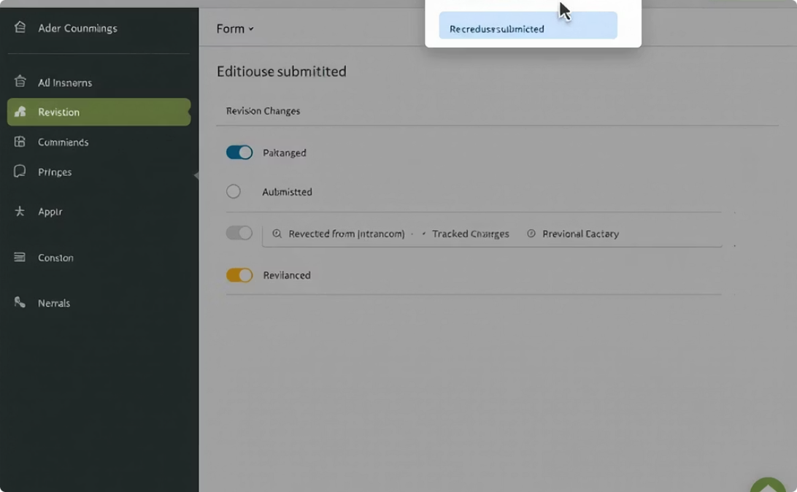
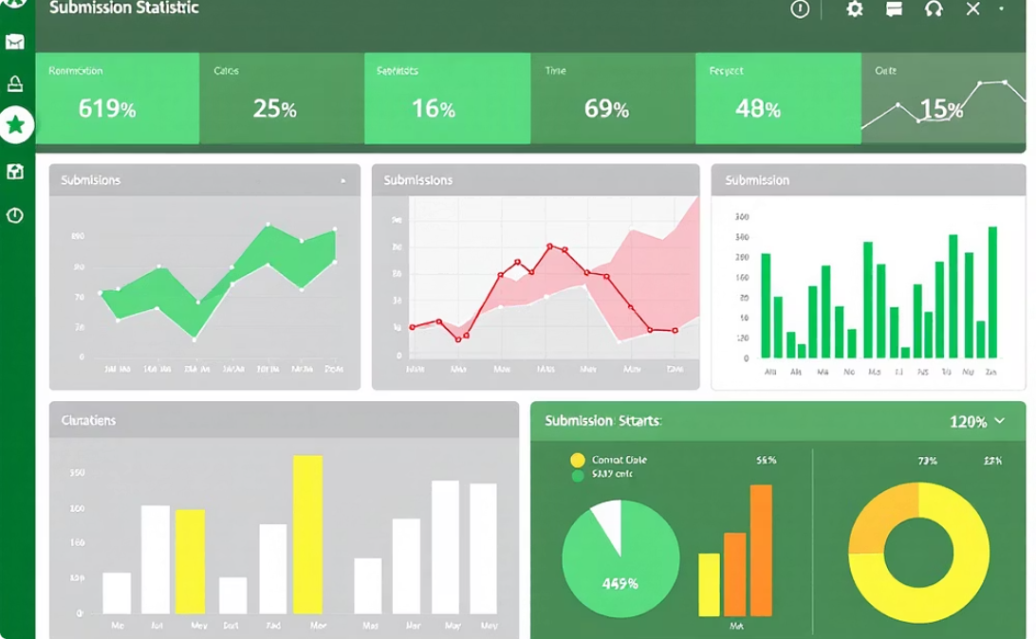
Submission History & Management
View History
Edit Submissions
Track Progress
Access a comprehensive list of all your past submissions, sortable by date, type, or status.
Update or correct information on pending reviews before final processing.
Monitor the status of all your submissions through our intuitive dashboard.
Video8.mp4 demonstrates how to navigate your submission history

Slide 10




Intelligent Chatbot Assistant
Your 24/7 Support Companion
Our advanced chatbot provides instant assistance with powerful features:
Streaming Replies
Get real-time responses that appear as they're generated, eliminating waiting time.
Session Reset
Start fresh conversations with a single click when changing topics.
Document Integration
Access user guides and wiki documentation directly through contextual RAG technology.
The chatbot integrates seamlessly with all form features, providing guidance exactly when you need it.

Slide 11
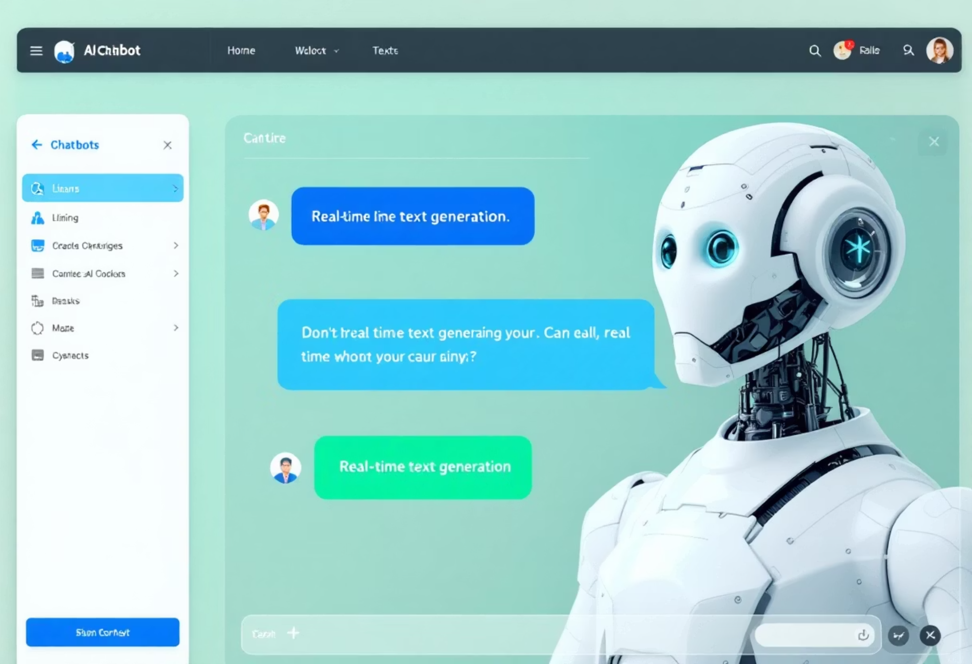
Intelligent Chatbot Demo
Live Demonstration Transcript
Video9.mp4
Opening the chatbot interface from any form page with a single click.
Asking the chatbot about address validation requirements, showing streaming replies as they appear.
Demonstrating how the chatbot accesses documentation to provide accurate form field guidance.
Requesting help with photo upload requirements for location reviews.
Using the session reset feature to start a new conversation about submission history.
Live demo showcasing all chatbot features in context of form submission workflow
The intelligent chatbot integrates with every step of the form submission process, providing contextual assistance exactly when users need it most, reducing support tickets by 67%.

